Slide 1
DEPLOYING WORDPRESS APPLICATION
- Bairagoni Bhargavi

Slide 2
Agenda
Deploying wordpress using :
RDS
docker compose file
git and Jenkins
Userdata
Jenkins execute shell
Pipeline(build periodically, poll scm)
Terraform
Jenkins (Terraform,execute shell(init,validate,fmt,apply))
k8s

Slide 3
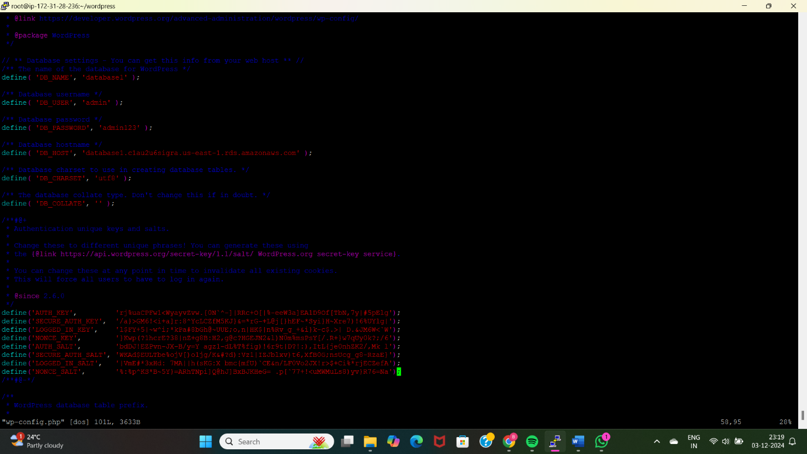
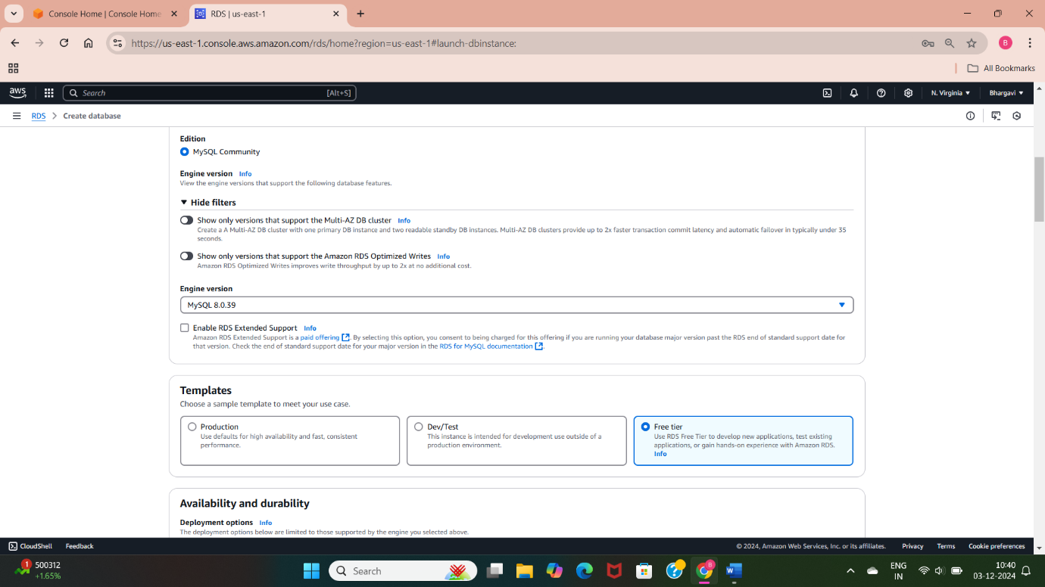
1. Deploy WordPress Web Application Using AWS RDS
Launch an EC2
Create RDS database instace.
CREATE USER 'wordpress' IDENTIFIED BY 'wordpress-pass’;
GRANT ALL PRIVILEGES ON wordpress.* TO 'wordpress’;
FLUSH PRIVILEGES;
EXIT;
Install httpd
Install php using sudo amazon-linux-extras install -y lamp-mariadb10.2-php7.2 php7.2

Slide 4
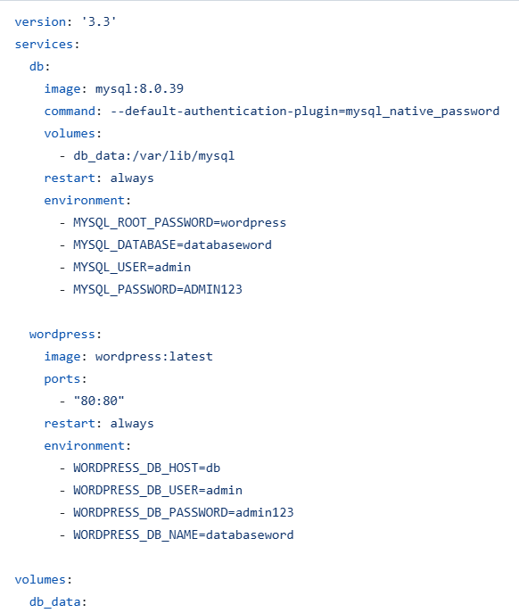
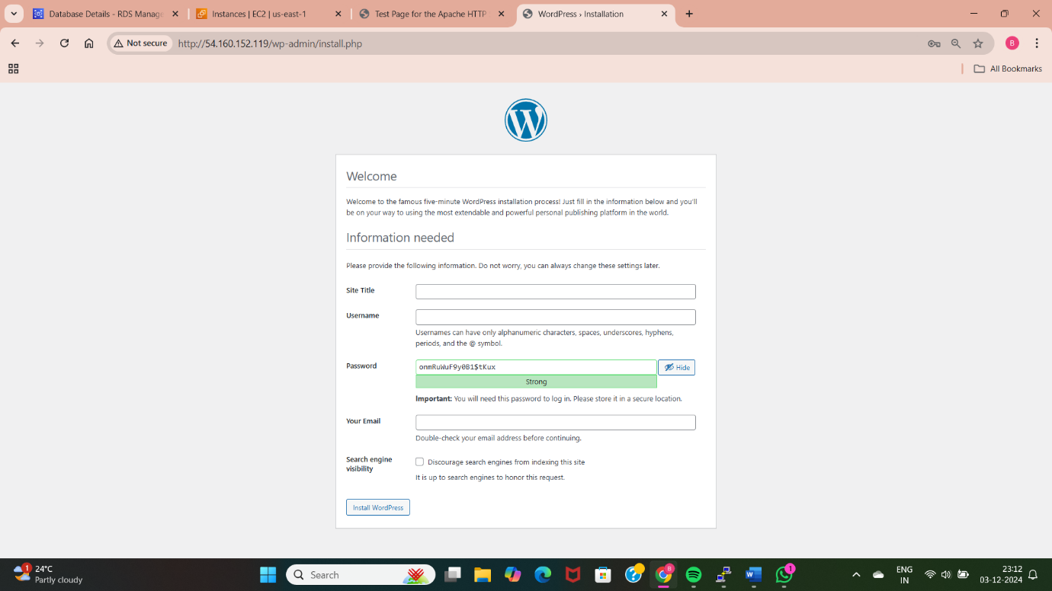
2. Deploy WordPress Web Application Using Docker Compose File
Write a docker-compose.yml file for deploying wordpress application and use mysql database configurations.
Use docker-compose up to deploy
Verify in browser using Public Ip address of instance.

Slide 5
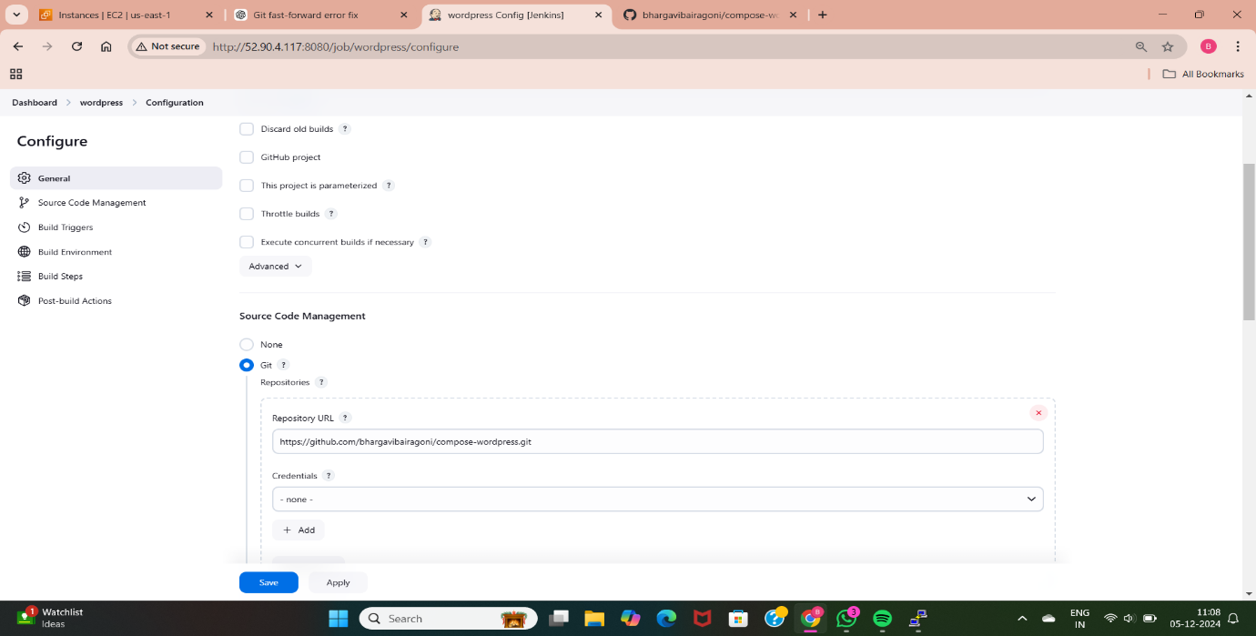
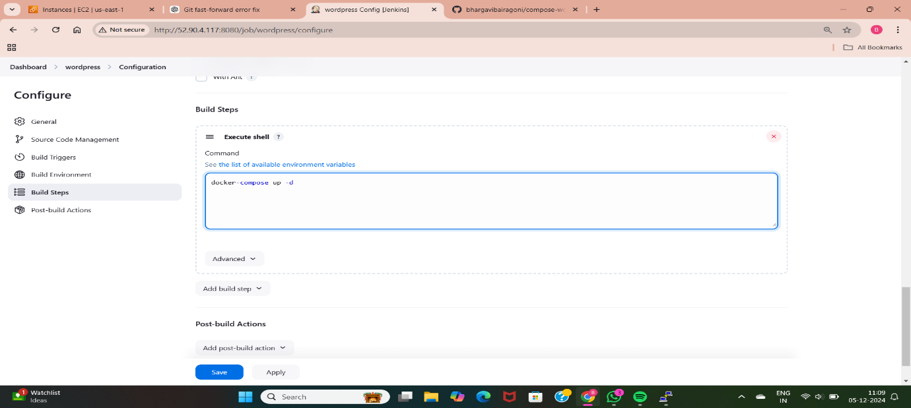
3. Deploy WordPress Web Application Using Git and Jenkins
Push code(docker-compose.yml) to Github
Create instance and install Jenkins.
Create a Jenkins freestyle job to pull the git repository.
Use Jenkins to deploy wordpress.

Slide 6
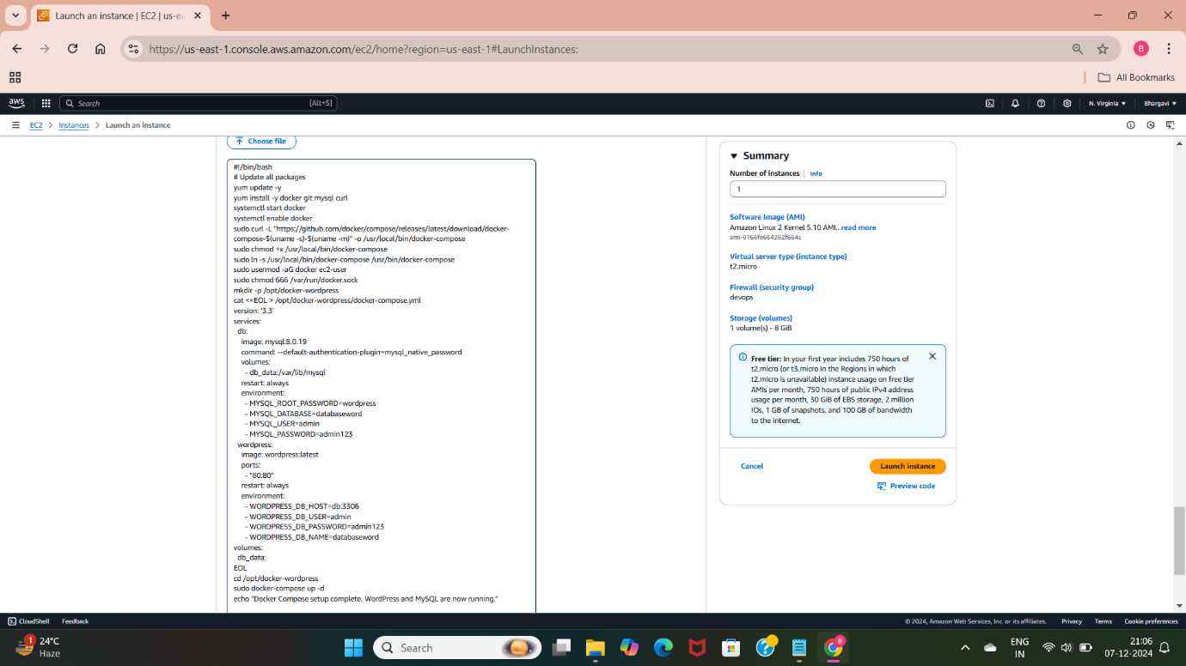
4.Deploy WordPress Web Application Using EC2 Instance User Data
Create an EC2 instance with a userdata script.
The userdata script installs wordpress, docker,docker-compose, mysql to deploy the wordpress application.
Access Wordpress application using the browser and public IP address of instance.

Slide 7
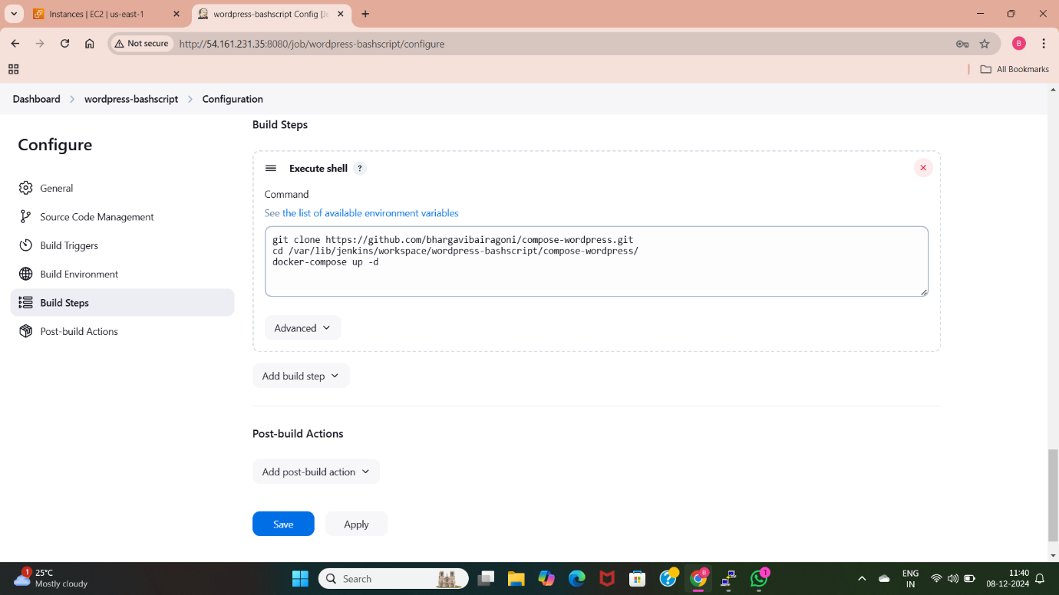
5. Deploy WordPress Web Application Using Git and Jenkins Execute Shell (Bash Script)
Clone the docker-compose file from the github.
Configure Jenkins to run the script
Write a bash script to set up wordpress
Check with the builds if it is success the wordpress application is deployed using Jenkins.
Access the application using the Ip address of instance.

Slide 8
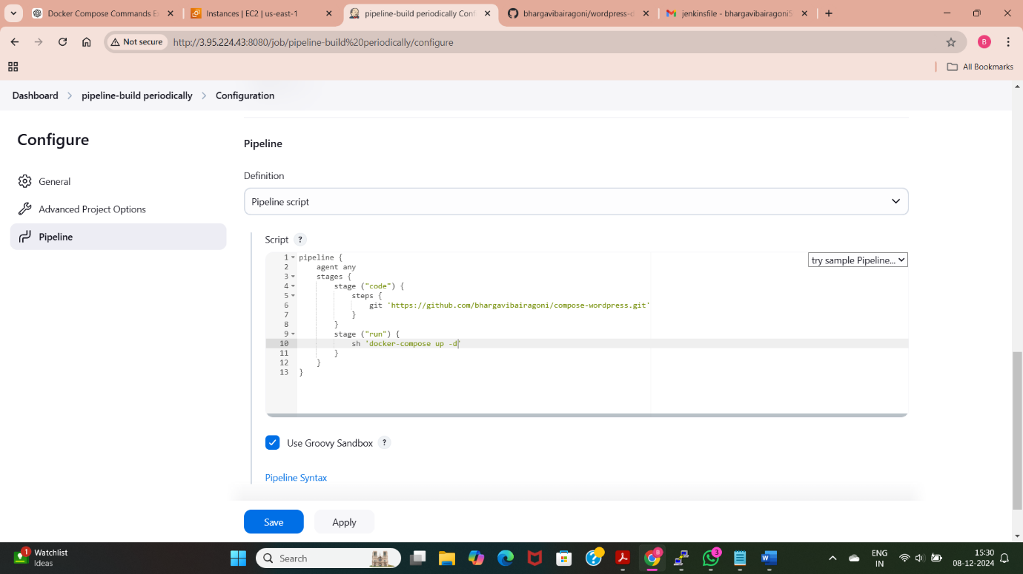
6. Deploy WordPress Using Jenkins Pipeline with Periodic Build and Poll SCM
Create a pipeline script for wordpress deployment.
Add “Build Periodically” and check whether the build are occurring according to the provided syntax.
Add “Poll SCM” and check the builds
Verify the github changes trigger the pipeline.

Slide 9
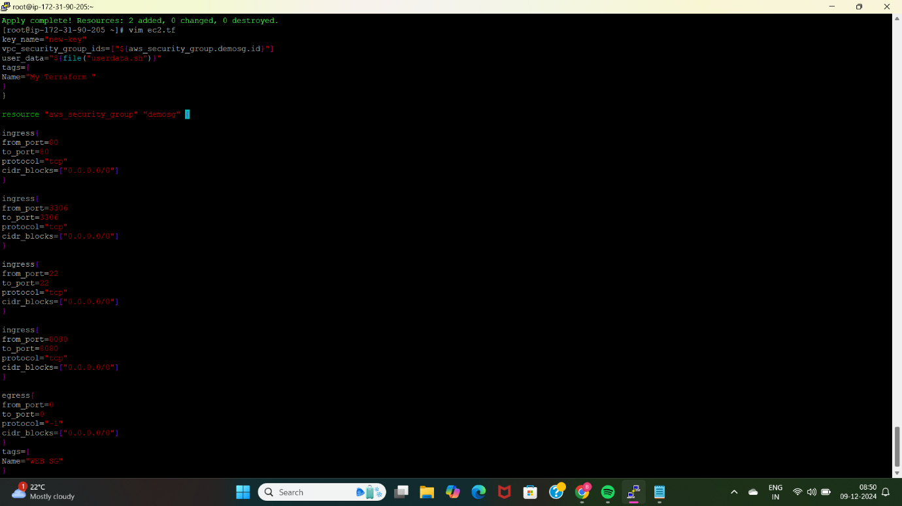
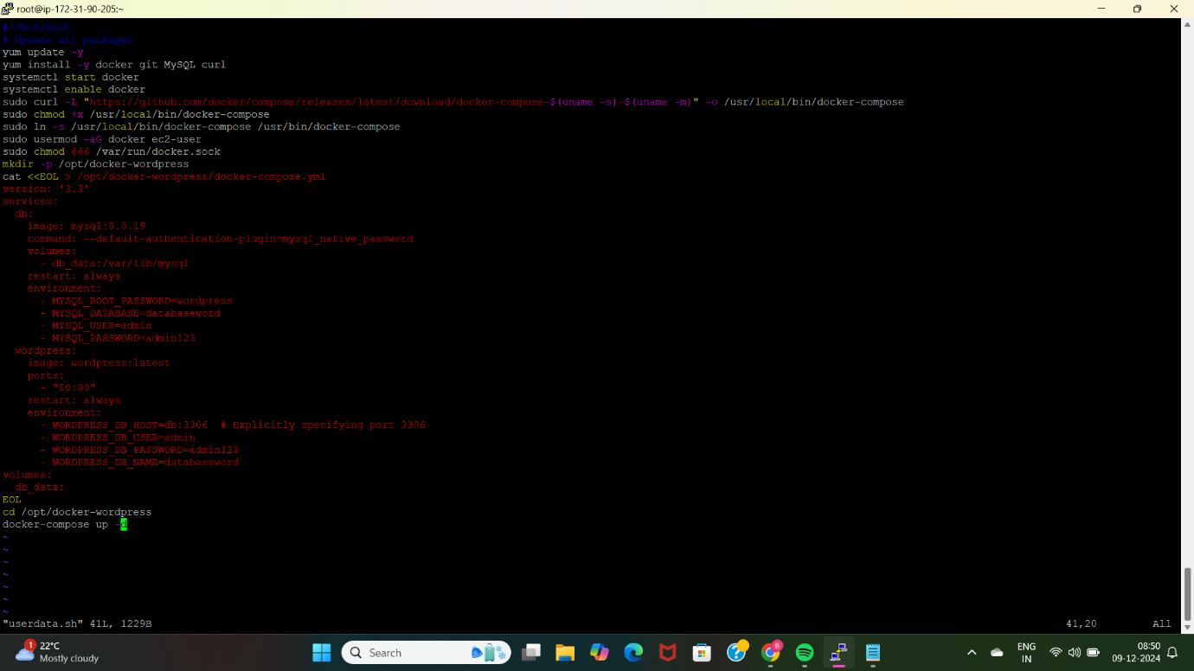
7. Deploy WordPress Using Terraform (EC2 with User Data Script)
Create a instance and install Terraform.
Write Terraform scripts for EC2 and userdata.
Run “terraform init”, “terraform validate”, “terraform apply”.
Push the code into github.
Access the wordpress in the browser

Slide 10
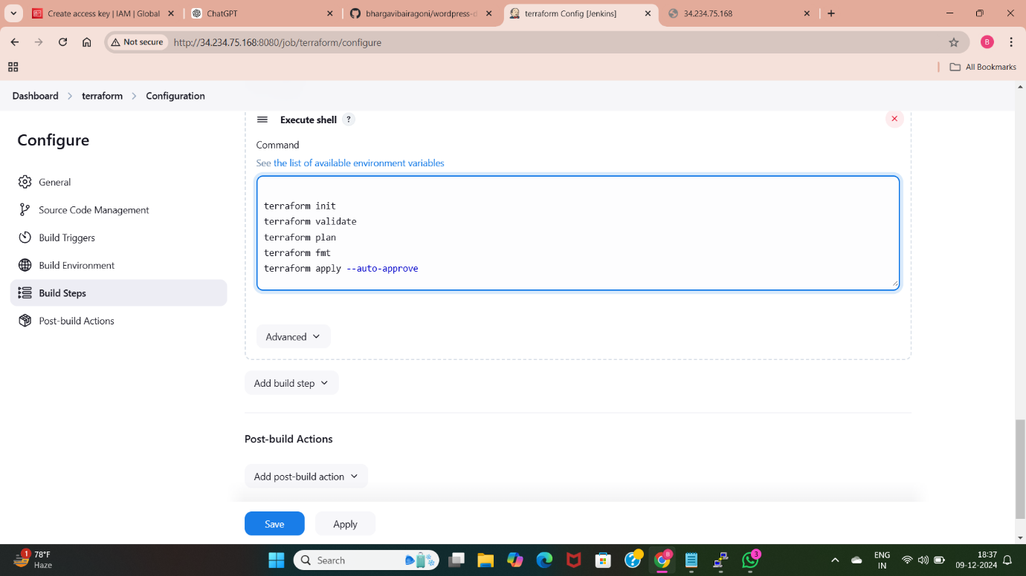
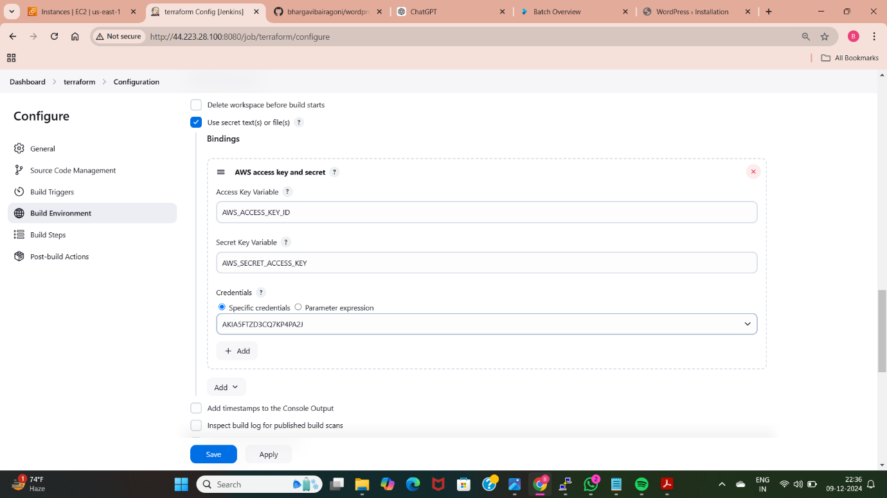
8. Deploy WordPress Using Git, Jenkins, and Terraform (Automated)
Clone the terraform script from github.
Add the aws credentials to Jenkins using plugin
Configure Jenkins to run terraform commands
Use “terraform apply –auto-approve” for deployment.

Slide 11
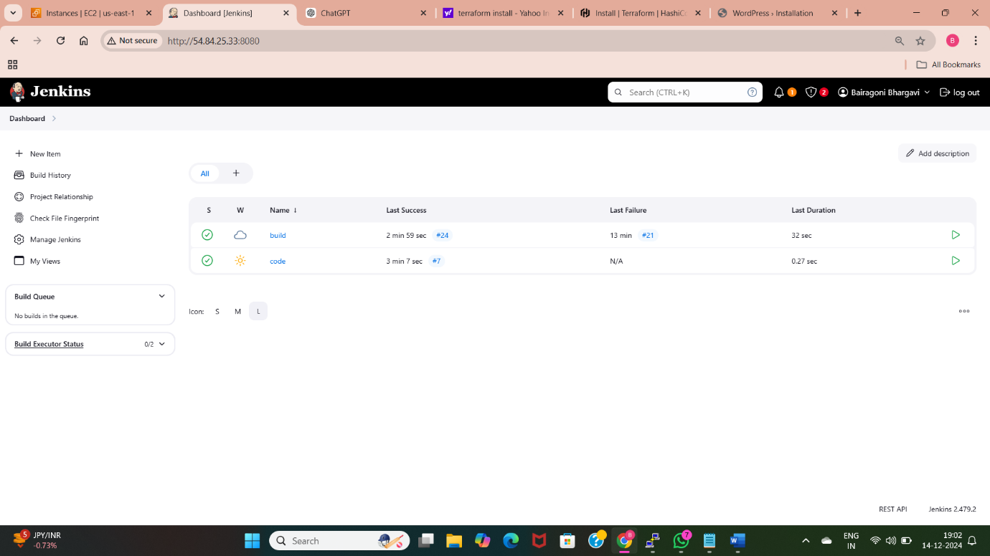
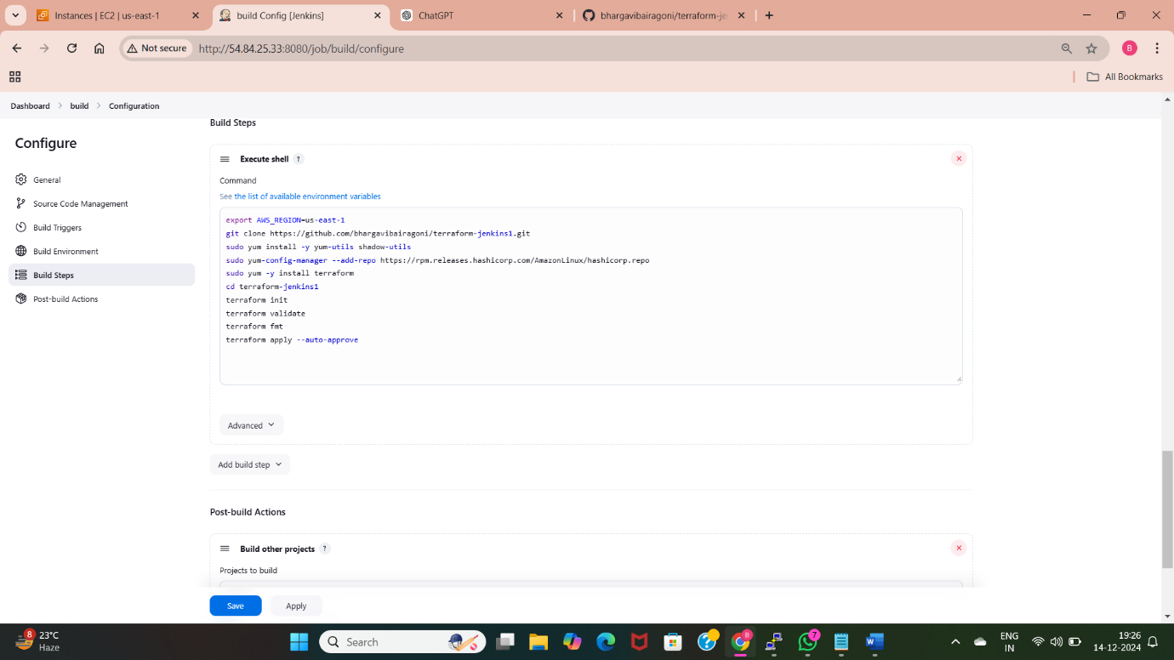
9.Deploy WordPress Using Jenkins Pipeline with Git and Terraform
Create two free style jobs in Jenkins.
Use a Jenkins freestyle pipeline to clone, validate and apply Terraform scripts.
Provide aws credentials.
Use build pipeline plugin, build after other projects to connect two free style job builds.
Add “Poll SCM” to detect Github changes.
Verify automated deployment.

Slide 12
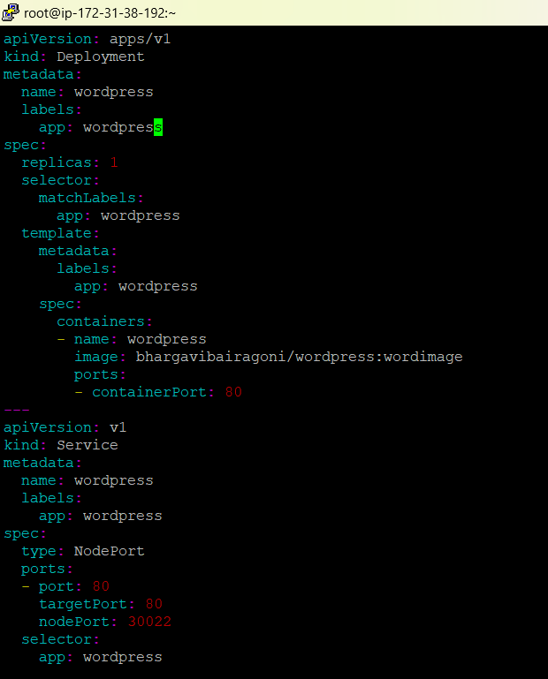
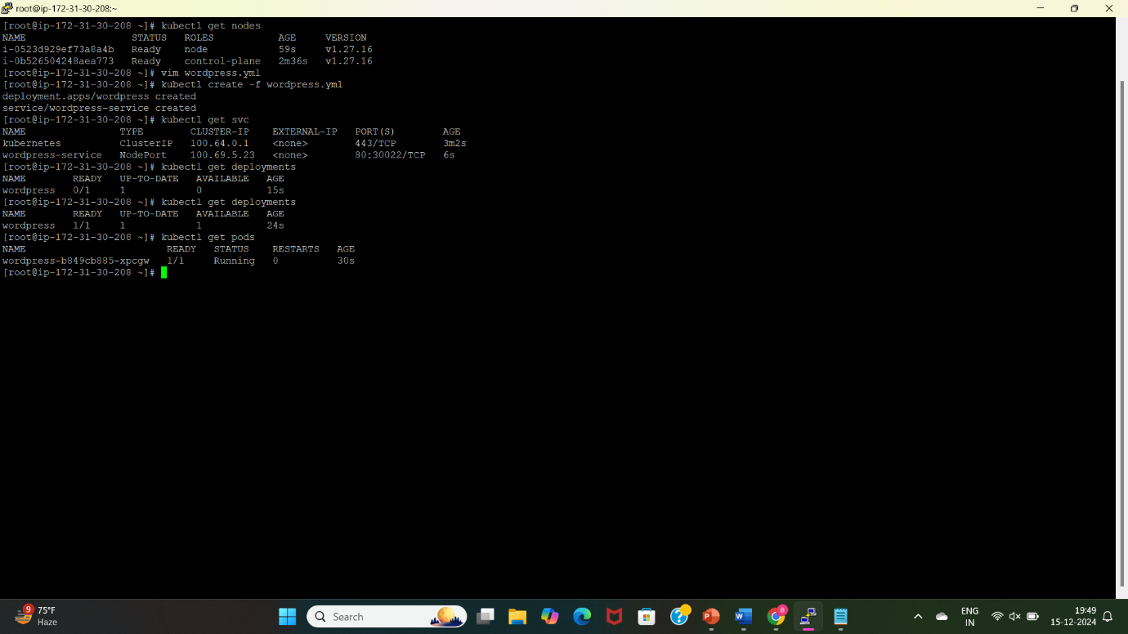
10. Deploy WordPress Using Kubernetes (Declarative Manifest)
Create a EC2 instance.
Install kubectl, kops and create clusters.
Write YAML manifests file for deploying wordpress application
Create service file for accessing the application.
Apply manifests using “kubectl create –f manifest file name”

Slide 13
Thank you

